Slide 1
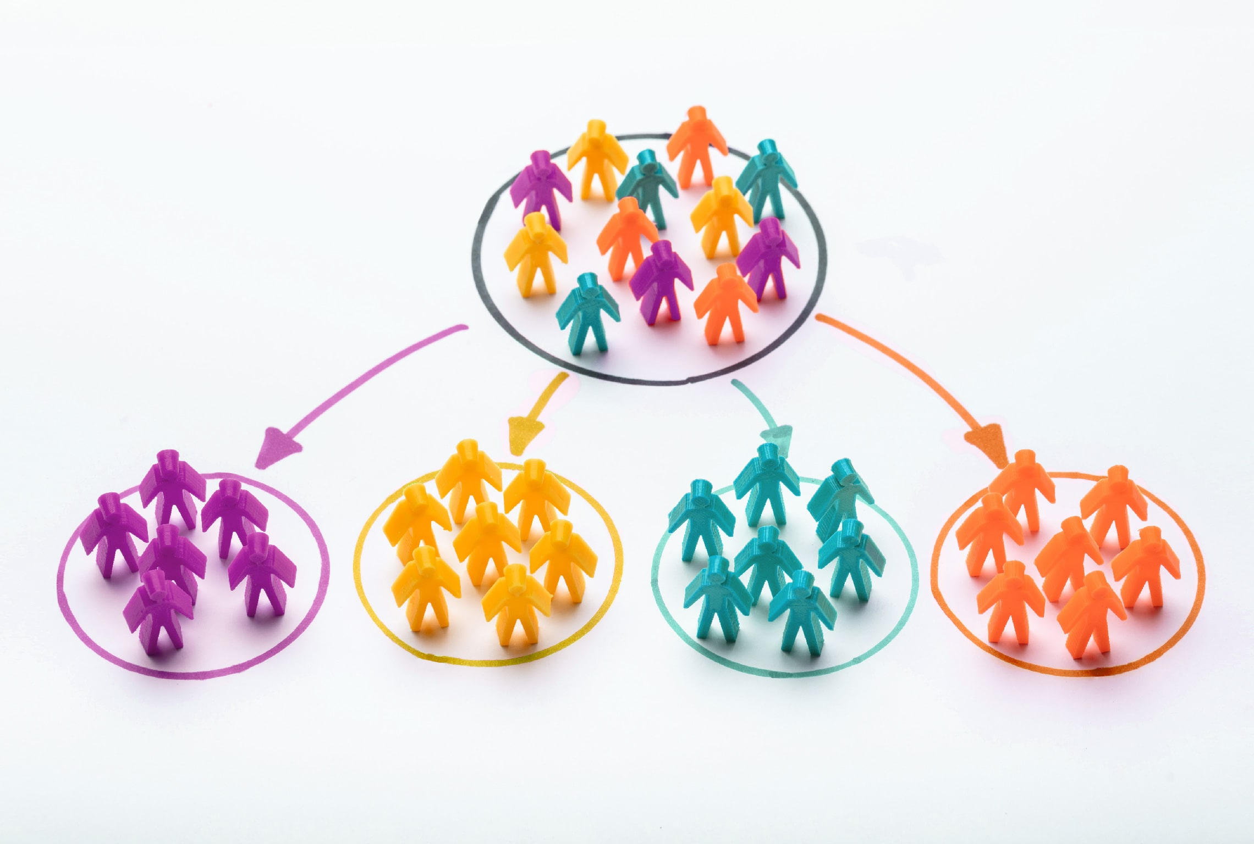

Customer Segmentation Using K-Means Clustering
Exposys Data Labs
SSM College Of Engg. & Tech.
Parihaspora, Pattan
Burhan Nabi (B.E/CSE)

Slide 2
CONTENTS:
Introduction
Objective
Existing Method
Proposed Method With Architecture
Implementation
Outcome And Result
Conclusion

Slide 3
INTRODUCTION
Over the years, the competition amongst businesses is increased and the large historical data that is available has resulted in the widespread use of data mining techniques in extracting the meaningful and strategic information from the database of the organisation.
Data mining is the process where methods are applied to extract data patterns in order to present it in the human readable format which can be used for the purpose of decision support.
Today where the world is being recognized as global village marketing has become vital ingredient for every business success. It is almost become difficult to every competitor to survive in market for a prolonged period because competition is cut to throat.
Change or die is the core faith of marketing. That is why development of right marketing strategy over time is required

Slide 4
OBJECTIVE
This case requires to develop a customer segmentation to understand customers behavior and separate them in different groups or cluster according to their preferences, and once the division is done, this information can be given to marketing team so they can plan the strategy accordingly.

Slide 5
EXISTING METHOD
Depending on the products and brand you are marketing, one method of customer segmentation might prove more effective than another. There are various customer segmentation techniques are there. We’ll analyse few of them.
Segmenting Clusters based on there needs
Segmenting Clusters based on Customer Sophistication
Segmenting Clusters based on Behaviour
Segmenting Clusters based on Firmographics
Segmenting Clusters based on Tiering

Slide 6
ARCHITECTURE
Clustering algorithms try to find natural clusters in data, the various aspects of how the algorithms to cluster data can be tuned and modified. Clustering is based on the principle that items within the same cluster must be similar to each other. The data is grouped in such a way that related elements are close to each other. In this project we’ll use K – Means clustering algorithm to segment the cluster.
K-Means Clustering
K-Means clustering is an unsupervised machine learning algorithm that divides the given data into the given number of clusters. Here, the “K” is the given number of predefined clusters, that need to be created.
It is a centroid based algorithm in which each cluster is associated with a centroid. The main idea is to reduce the distance between the data points and their respective cluster centroid.

Slide 7
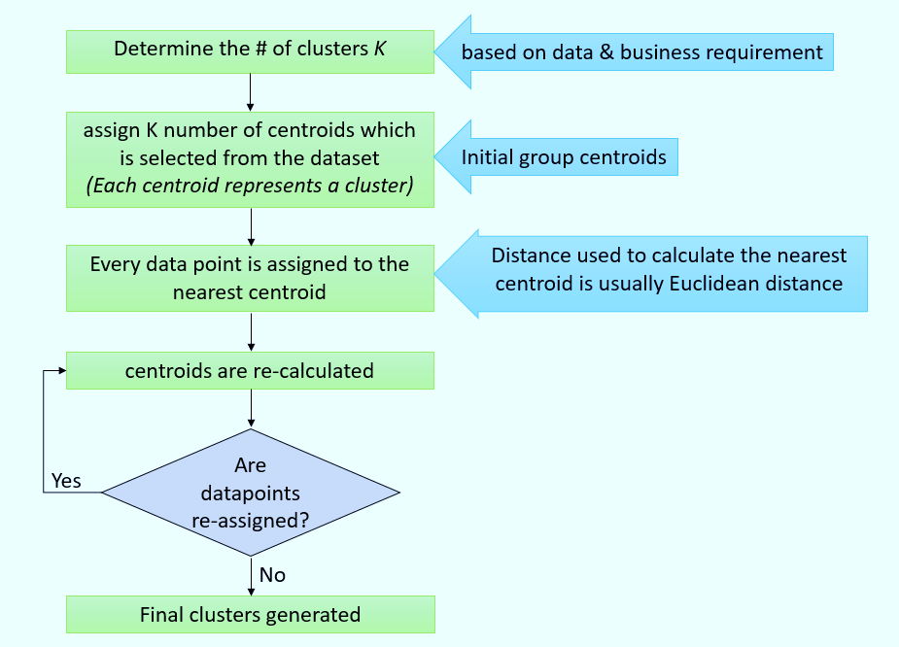

Slide 8
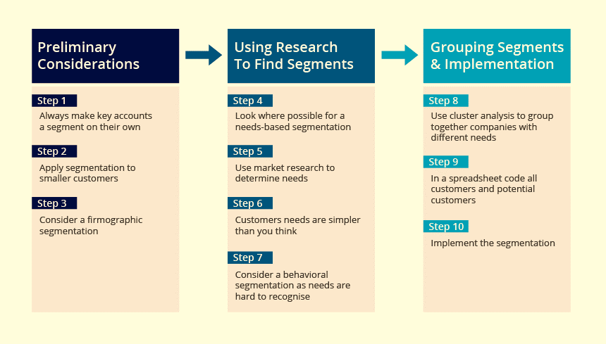
IMPLEMENTATION

Slide 9
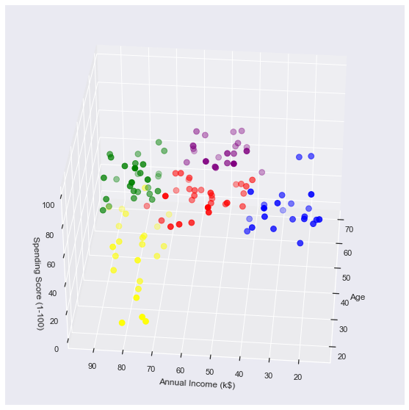
RESULT AND OUTCOME

Slide 10
CONCLUSION
K means clustering is one of the most popular clustering algorithms and usually the first thing practitioners apply when solving clustering tasks to get an idea of the structure of the dataset.
The goal of K means is to group data points into distinct non-overlapping subgroups. One of the major application of K means clustering is segmentation of customers to get a better understanding of them which in turn could be used to increase the revenue of the company.
addyouremail@freepik.com

